Slide 1

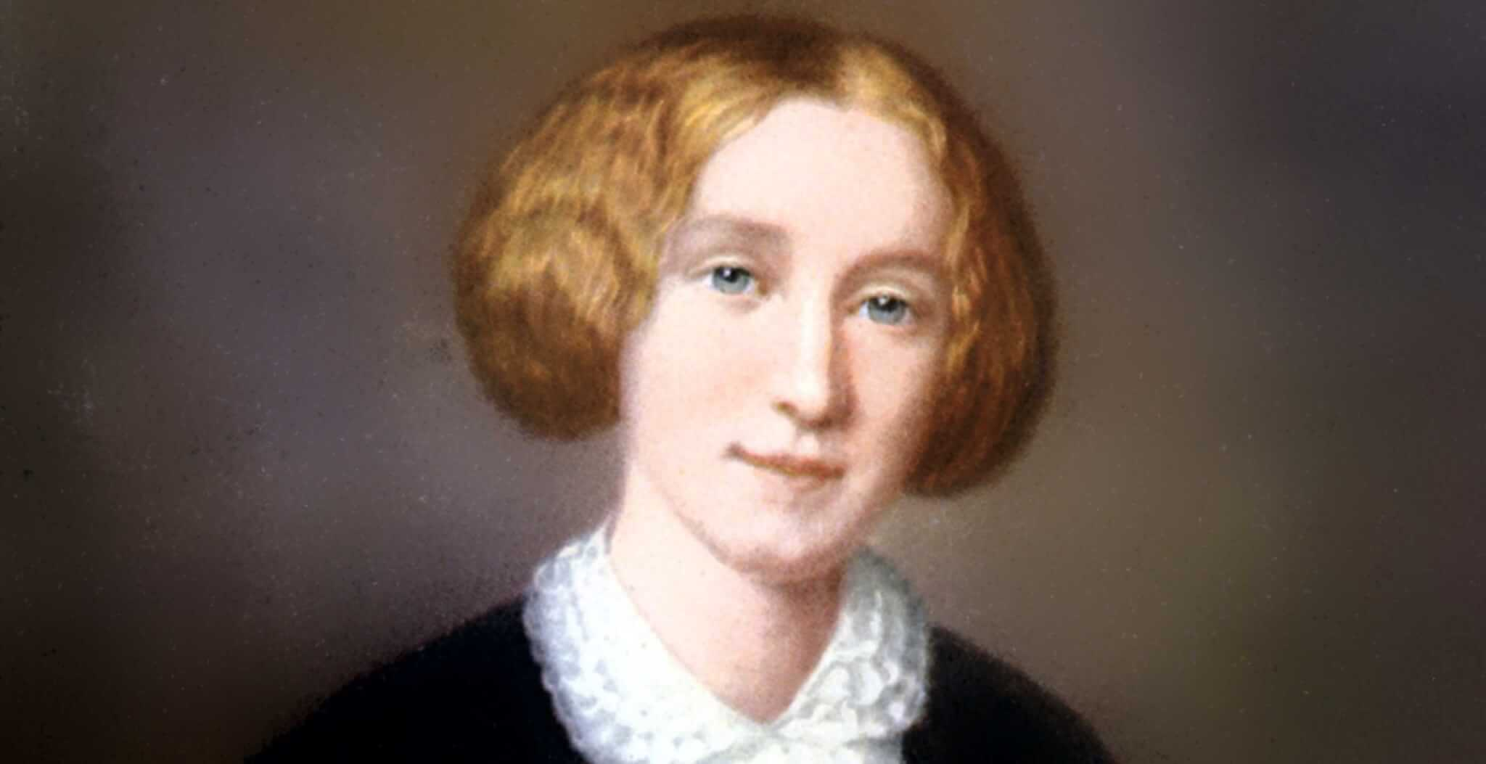
The George Eliot Archives
Team 6a
Project Sponsor:
Beverley Park Rilett, Ph.D.
Project Devs:
Brad Hughes (Developer) Ravindra Joshi (Grad Student)
Senior Design Member:
George Martin

Slide 2
System Metaphor
The George Eliot Archive is a digital humanities project and website used by scholars, researchers, and students when looking into the life of author George Eliot.
George Eliot is the pen name of Mary Ann Evans that she maintained throughout her life. The website hosts all of George Eliot's public literary works, articles about her, and intimate verifiable details regarding her life.
The website's intent is to be the most complete, accurate, and trusted source for researchers interested in George Eliot. The exhibit is designed to not only host verified information about George Eliot, but to display it in an interactive (dynamic) and visually appealing way for easy referencing and research.

Slide 3
Project Description (02/22/23)
I will be working under the direction of Dr. Bev and given project focus and tasking that is subject to change throughout the semester. Our currently agreed upon goals for this semester are listed below:
(Cycle 1) – Develop a proof of concept that will allow users to view and search the George Eliot journals on the site (private view). – COMPLETED
(Cycle 2) – Updated because project is ahead of schedule. Refactor and refine the proof of concept into a fully functioning version that is able to display professionally formatted and real time updates to the journals. (publish to live site)
(Cycle 3) – Add interactive elements to the page and hyperlink functionality to the results. Possibly begin co-op with 6b to merge journals into the chronology.

Slide 4
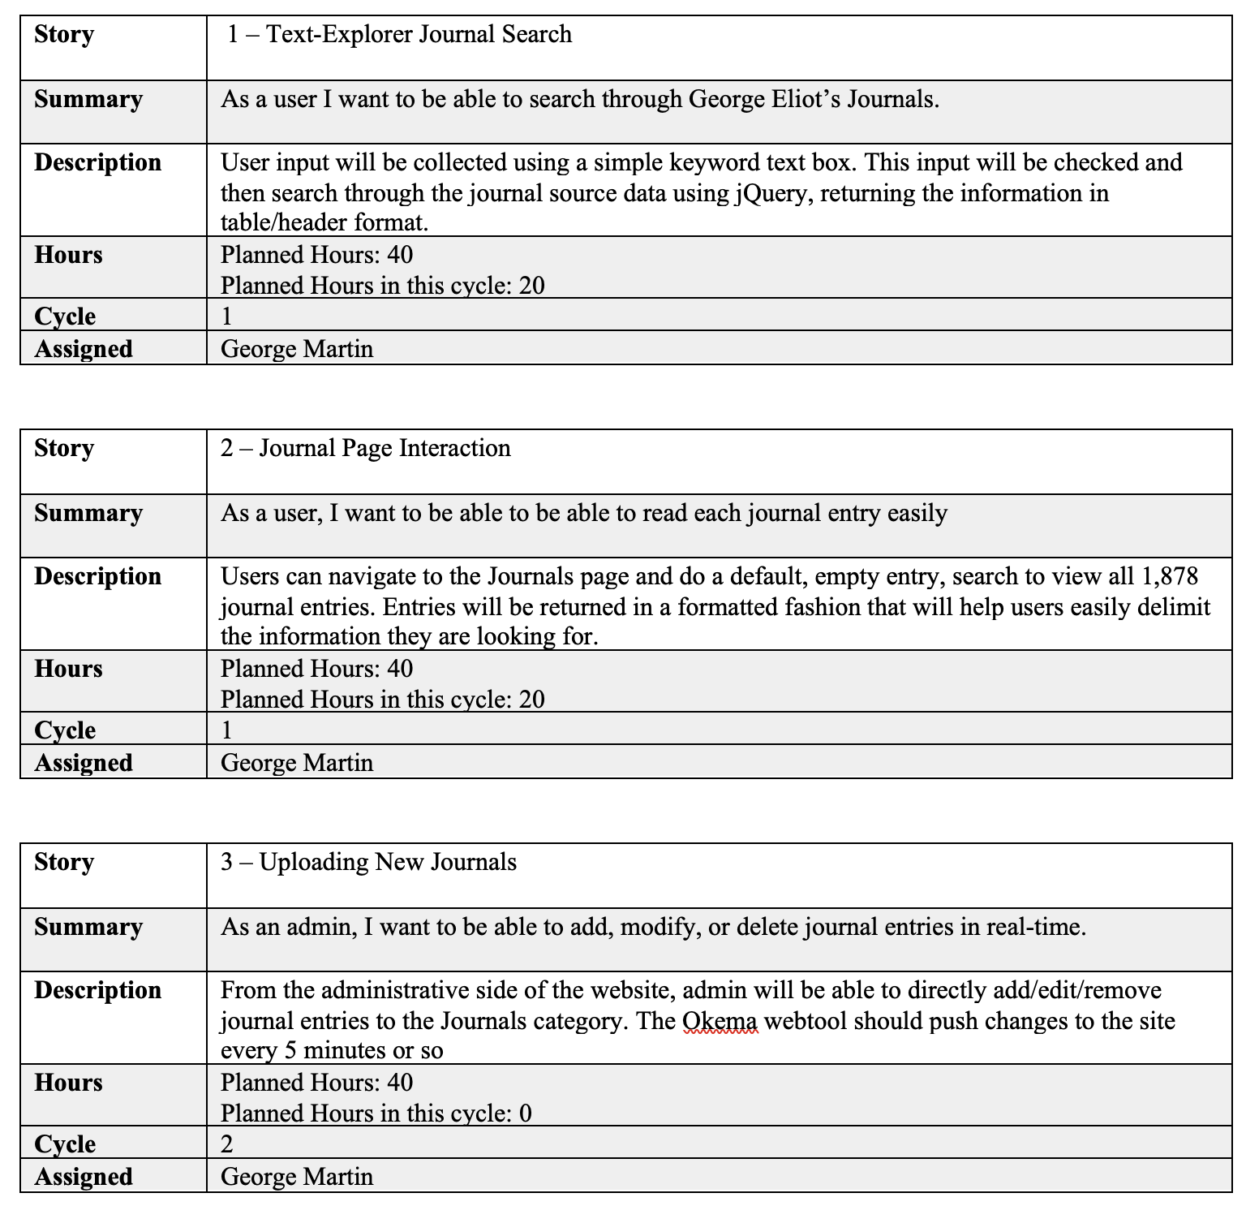
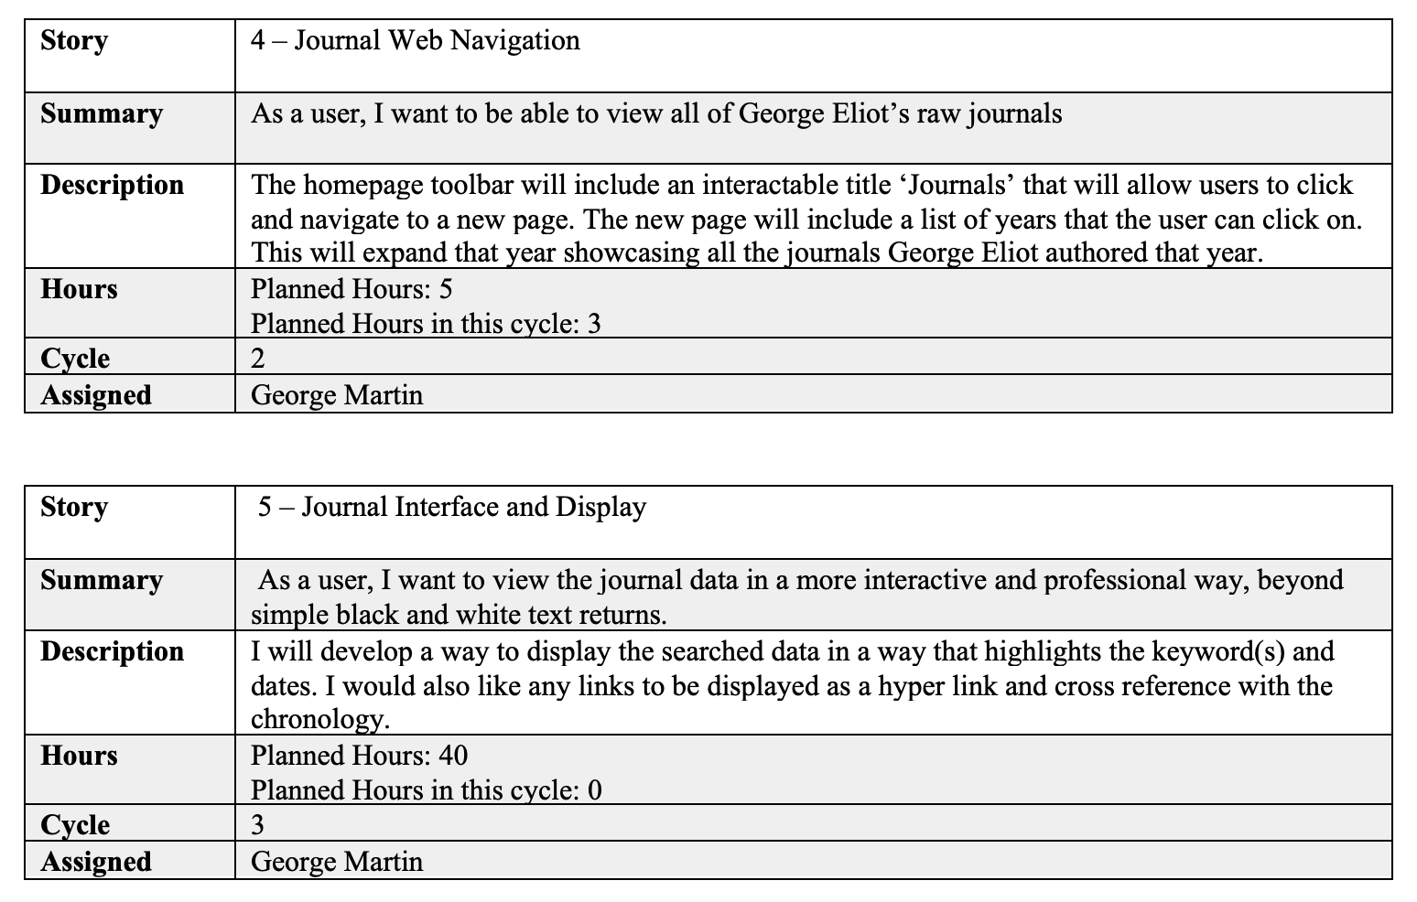
User Stories

Slide 5
Cycle 1 Intent:
Design, develop, and provide a working ‘proof of concept’ that enable users to do the following:
View all 1,878 journal entries by George Eliot.
Search through the journal entries by keyword or date.
Display journals using table formatting.

Slide 6
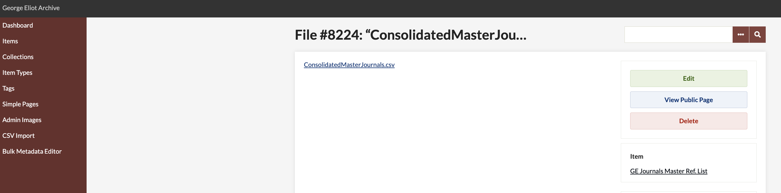
Cycle 1 Review
Journal data was aggregated from a .csv file. This was originally simplified for a proof of concept and later substituted with the full working file.
Formatting was the most challenging aspect, taking approximately 2 weeks to solve. (More on that later)
While ahead of schedule, search functionality was modified from a static search (button click) to live search, where search results update per character.
Color was also added to the table and search field for a more appealing view.
.csv file containing all 1,878 journal entries.
Collections GH Page

Slide 7
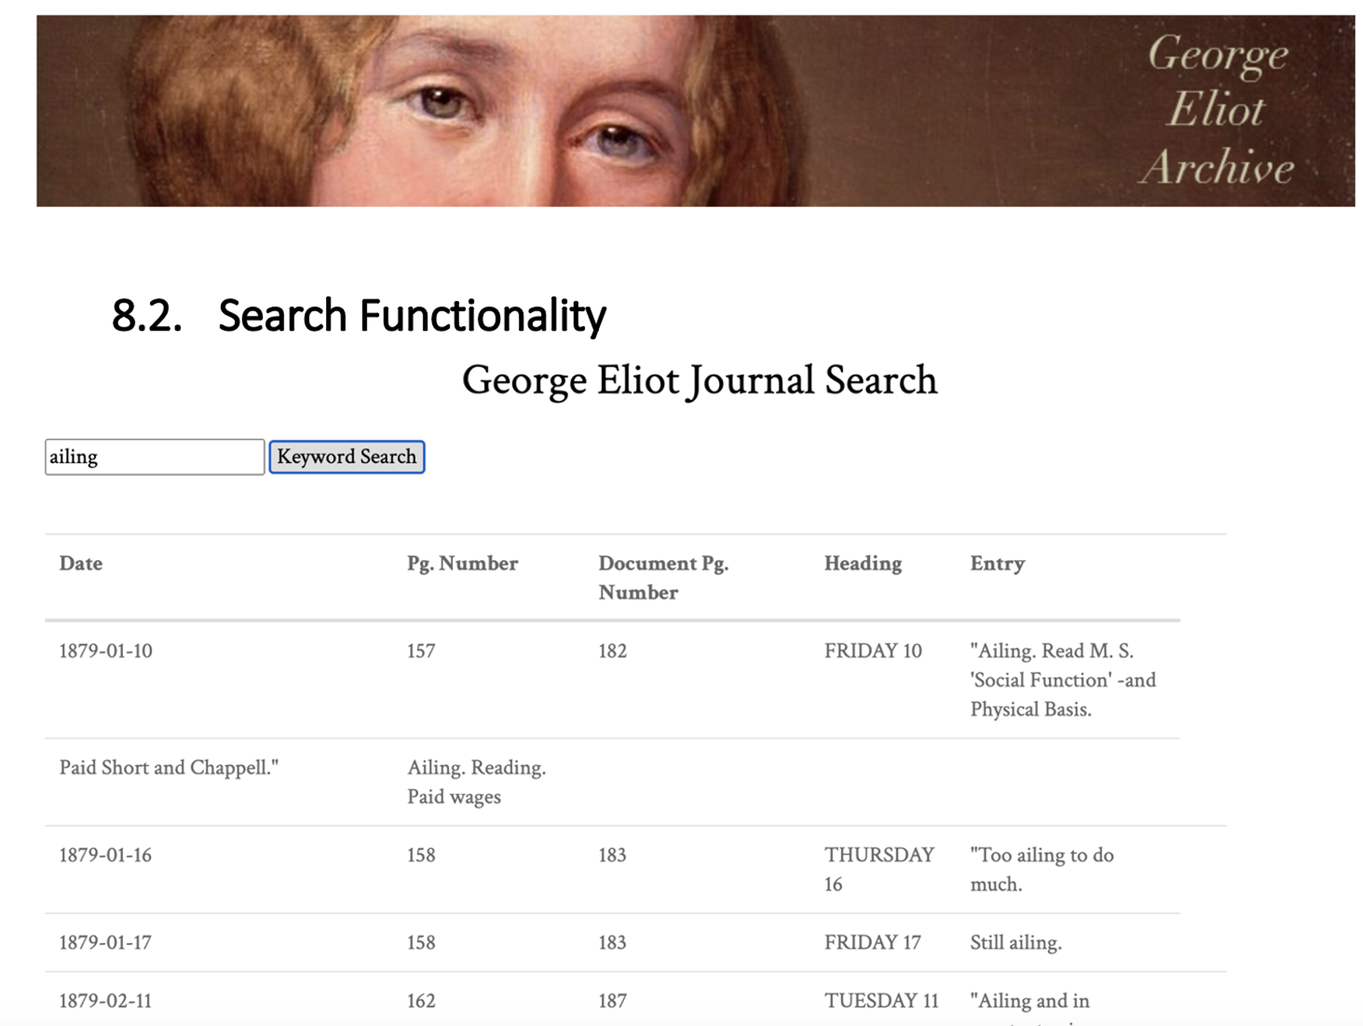
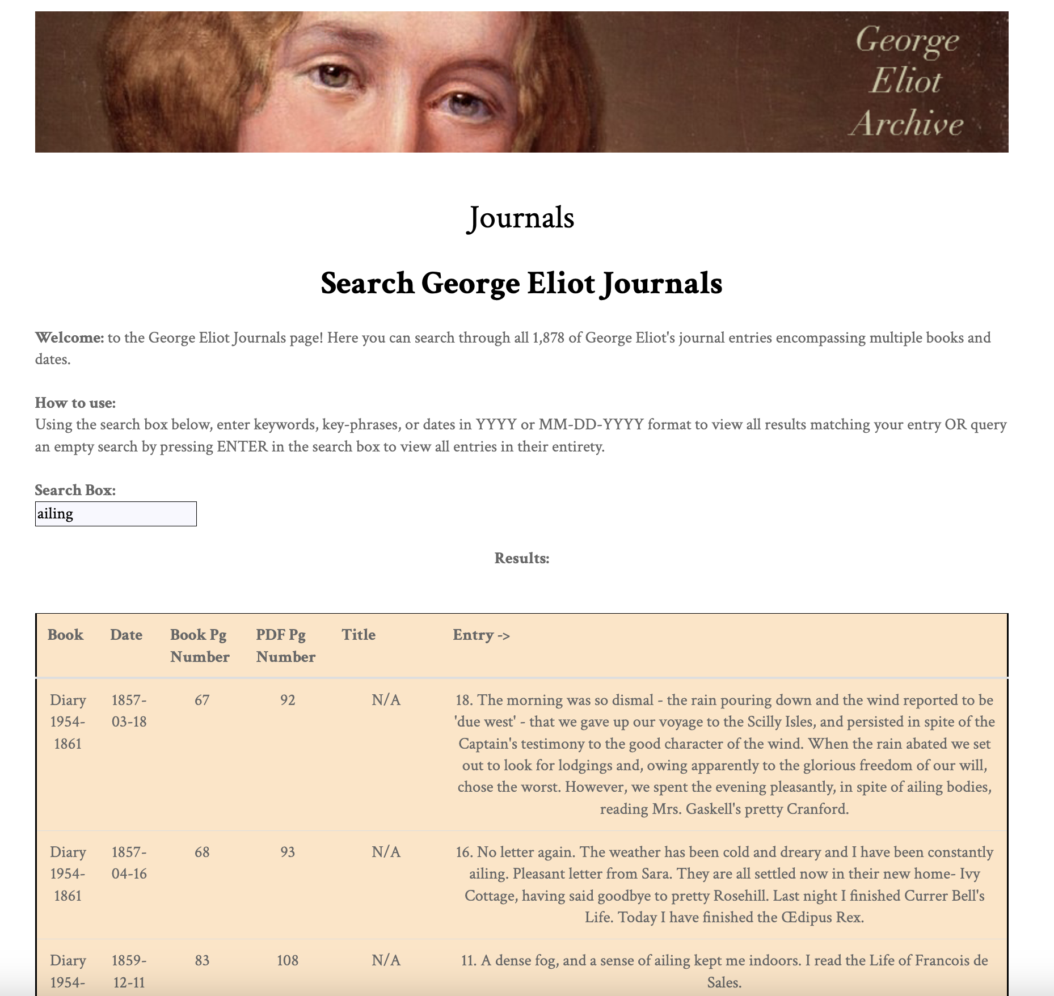
Original Proof of Concept (*with formatting bug)
Updated Version (*ahead of schedule)
Formatting issue caused by /n in .csv file

Slide 8
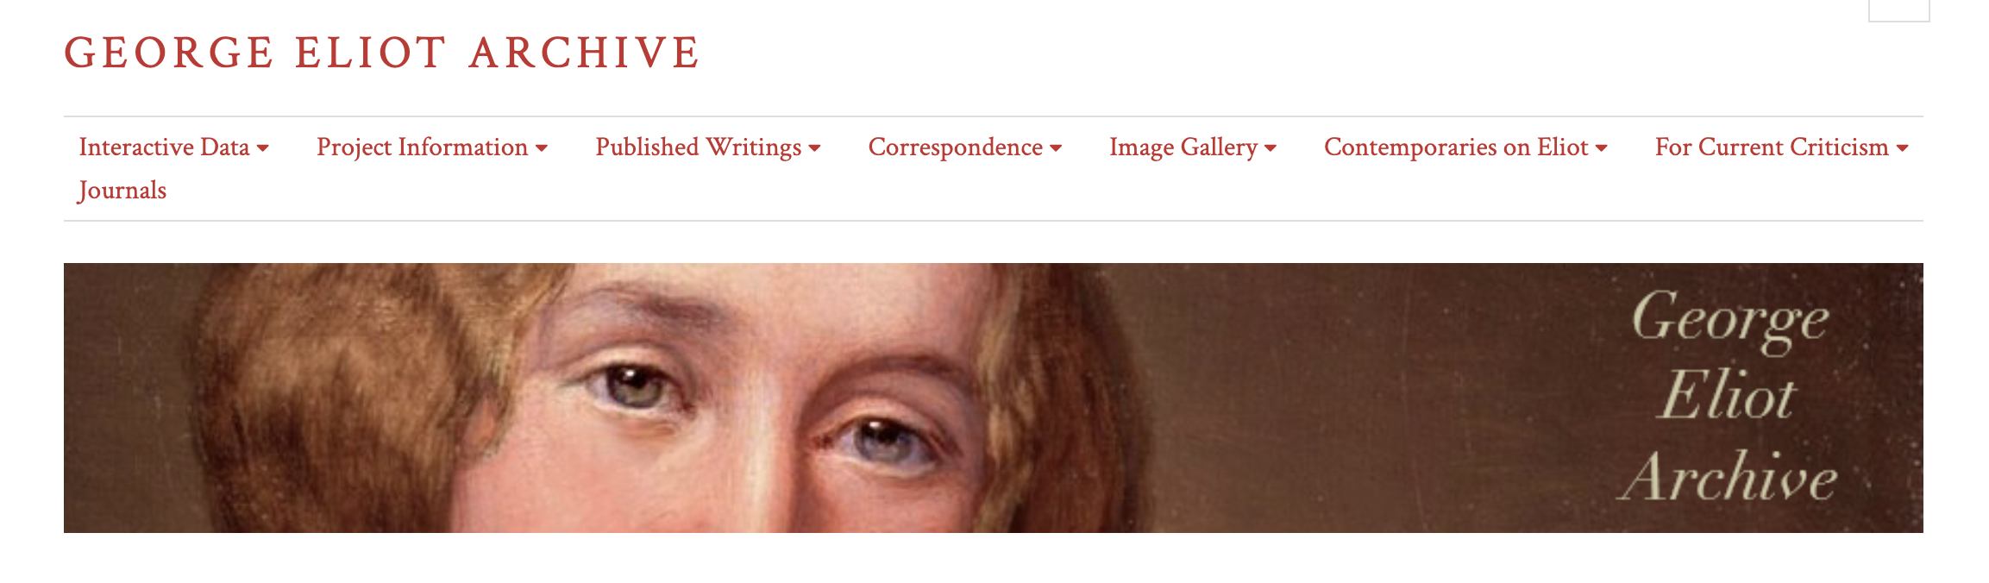
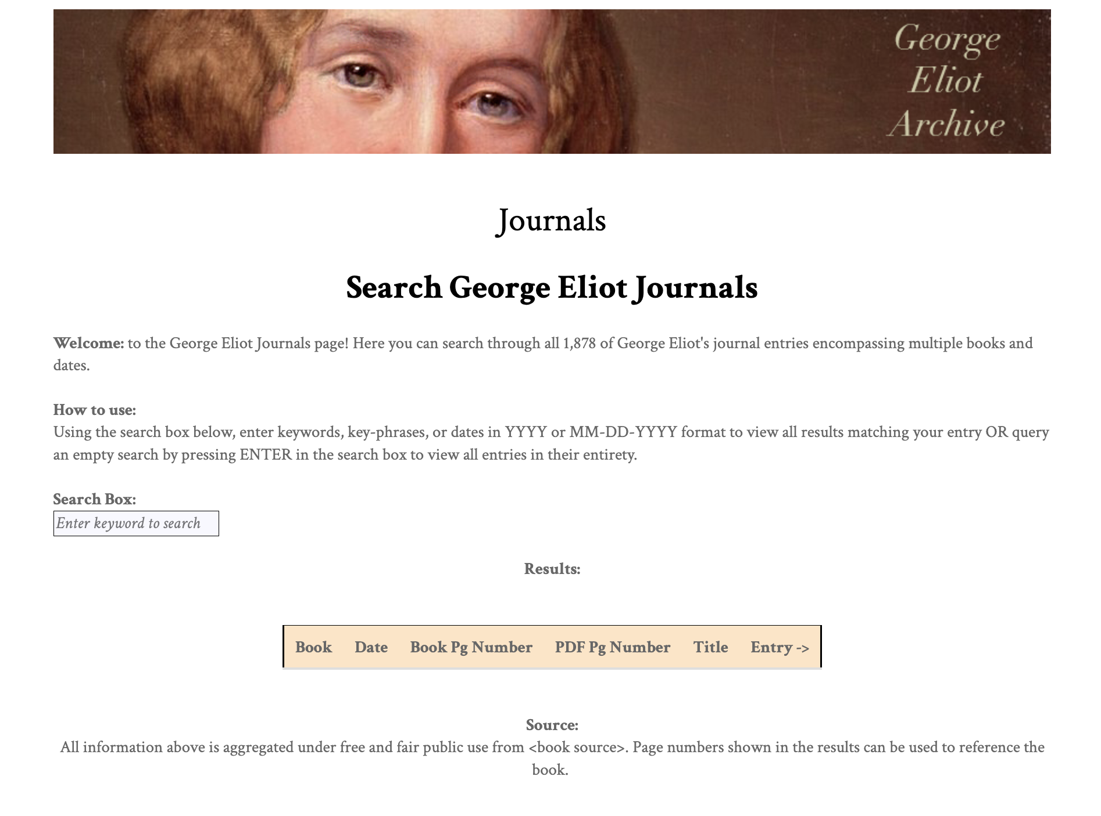
Design Flow

Slide 9
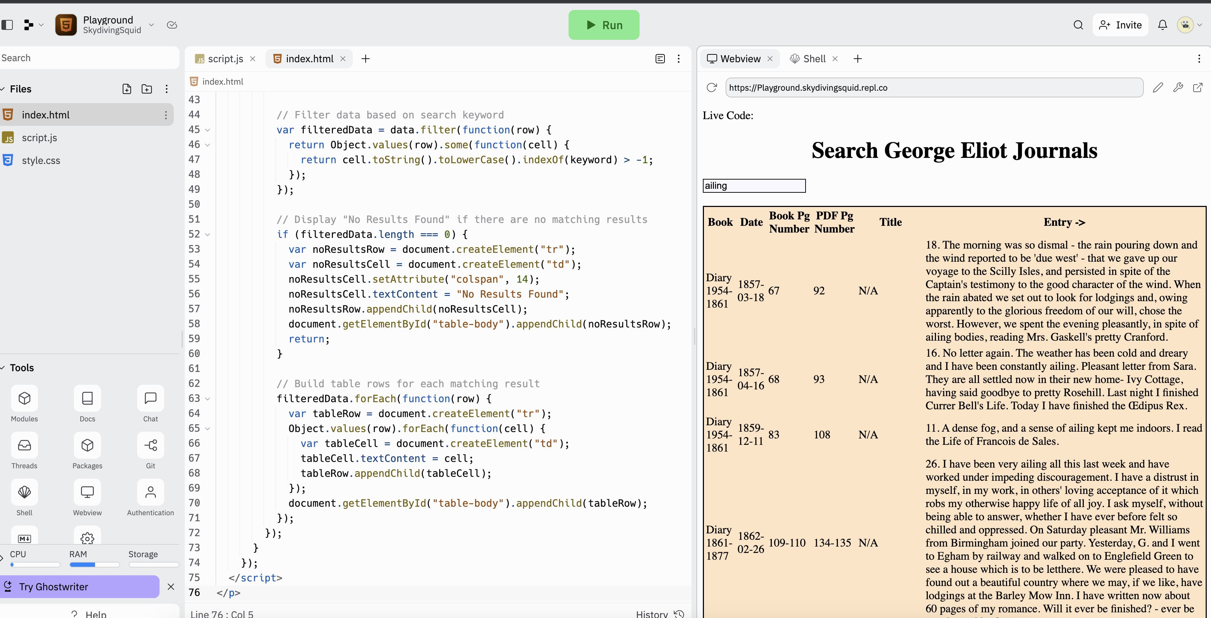
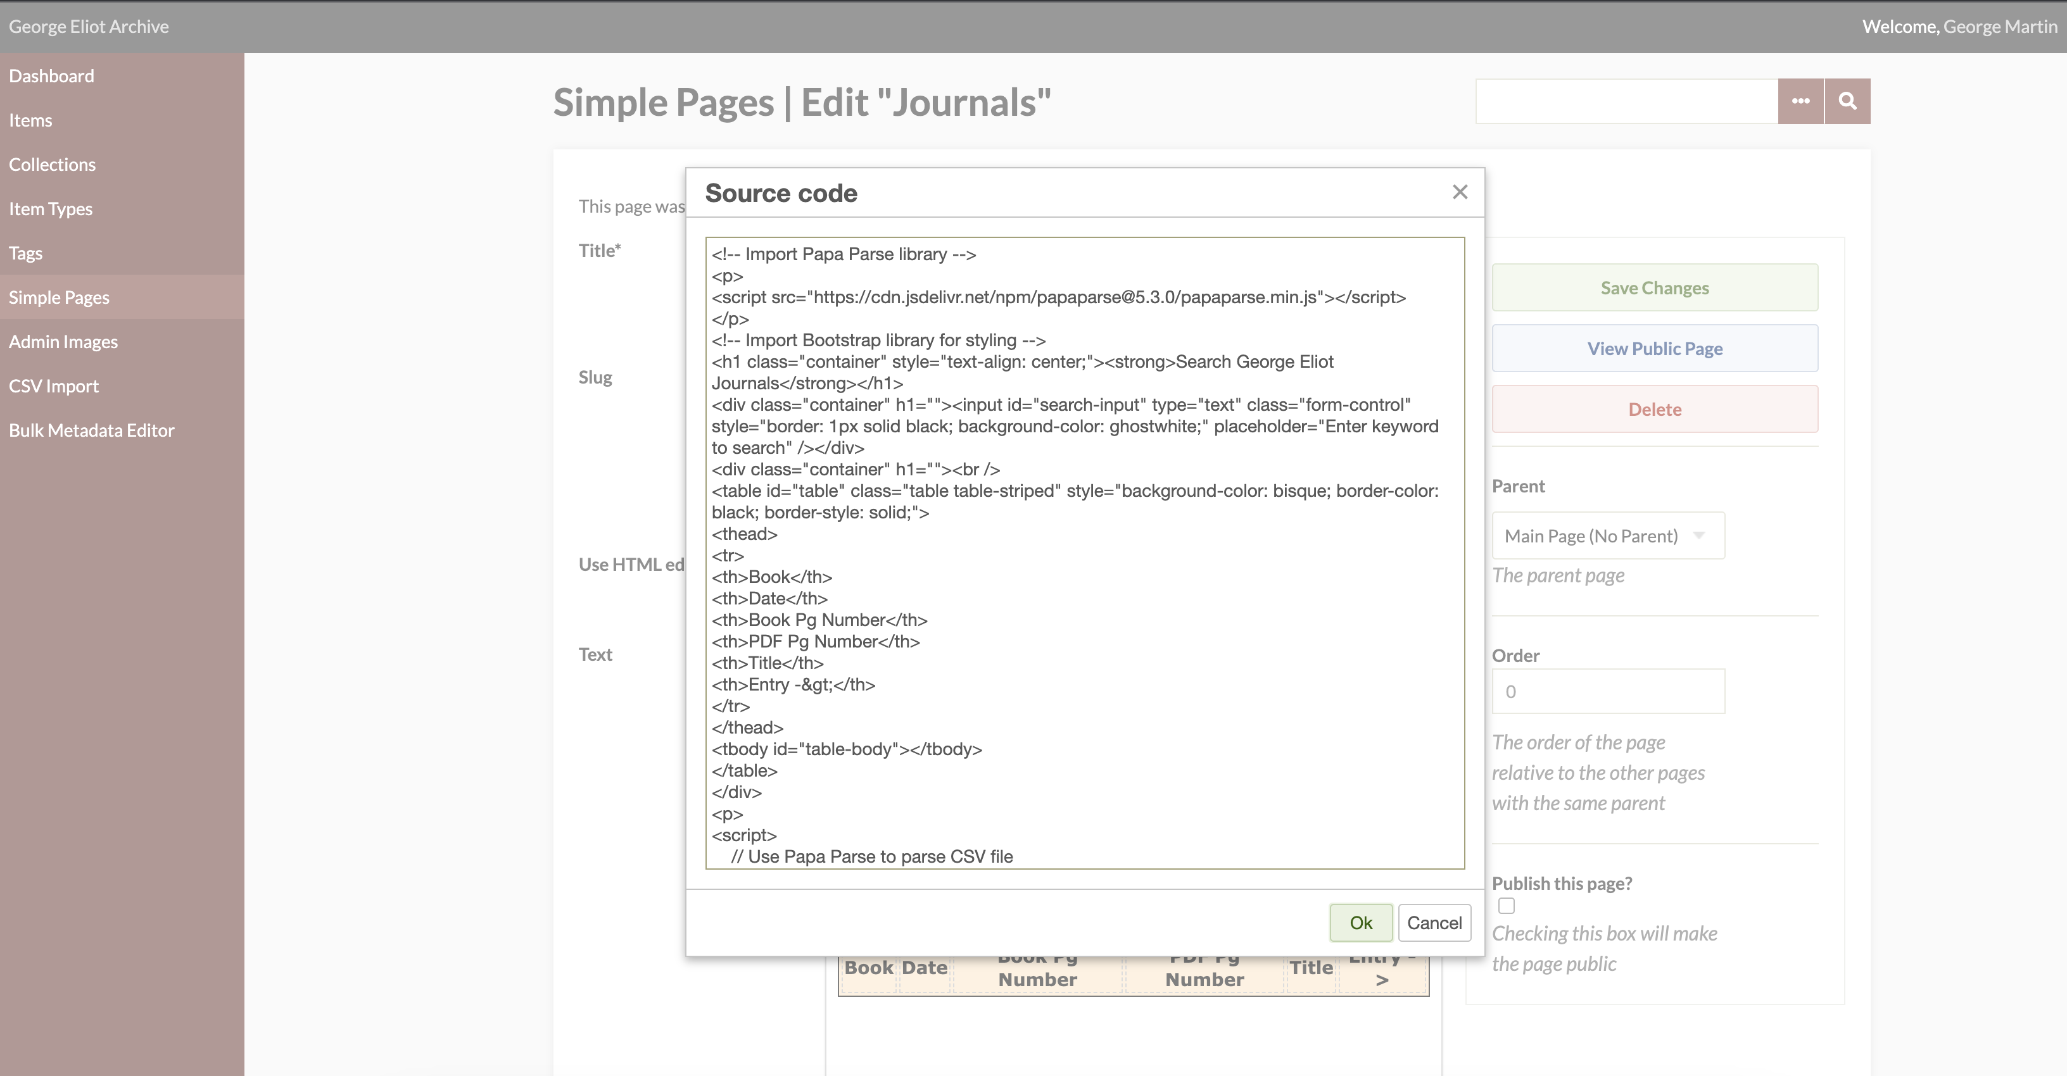
Coding Platform
Replit.com playground to see code before merger.
Coding interface on the live host-site.

Slide 10
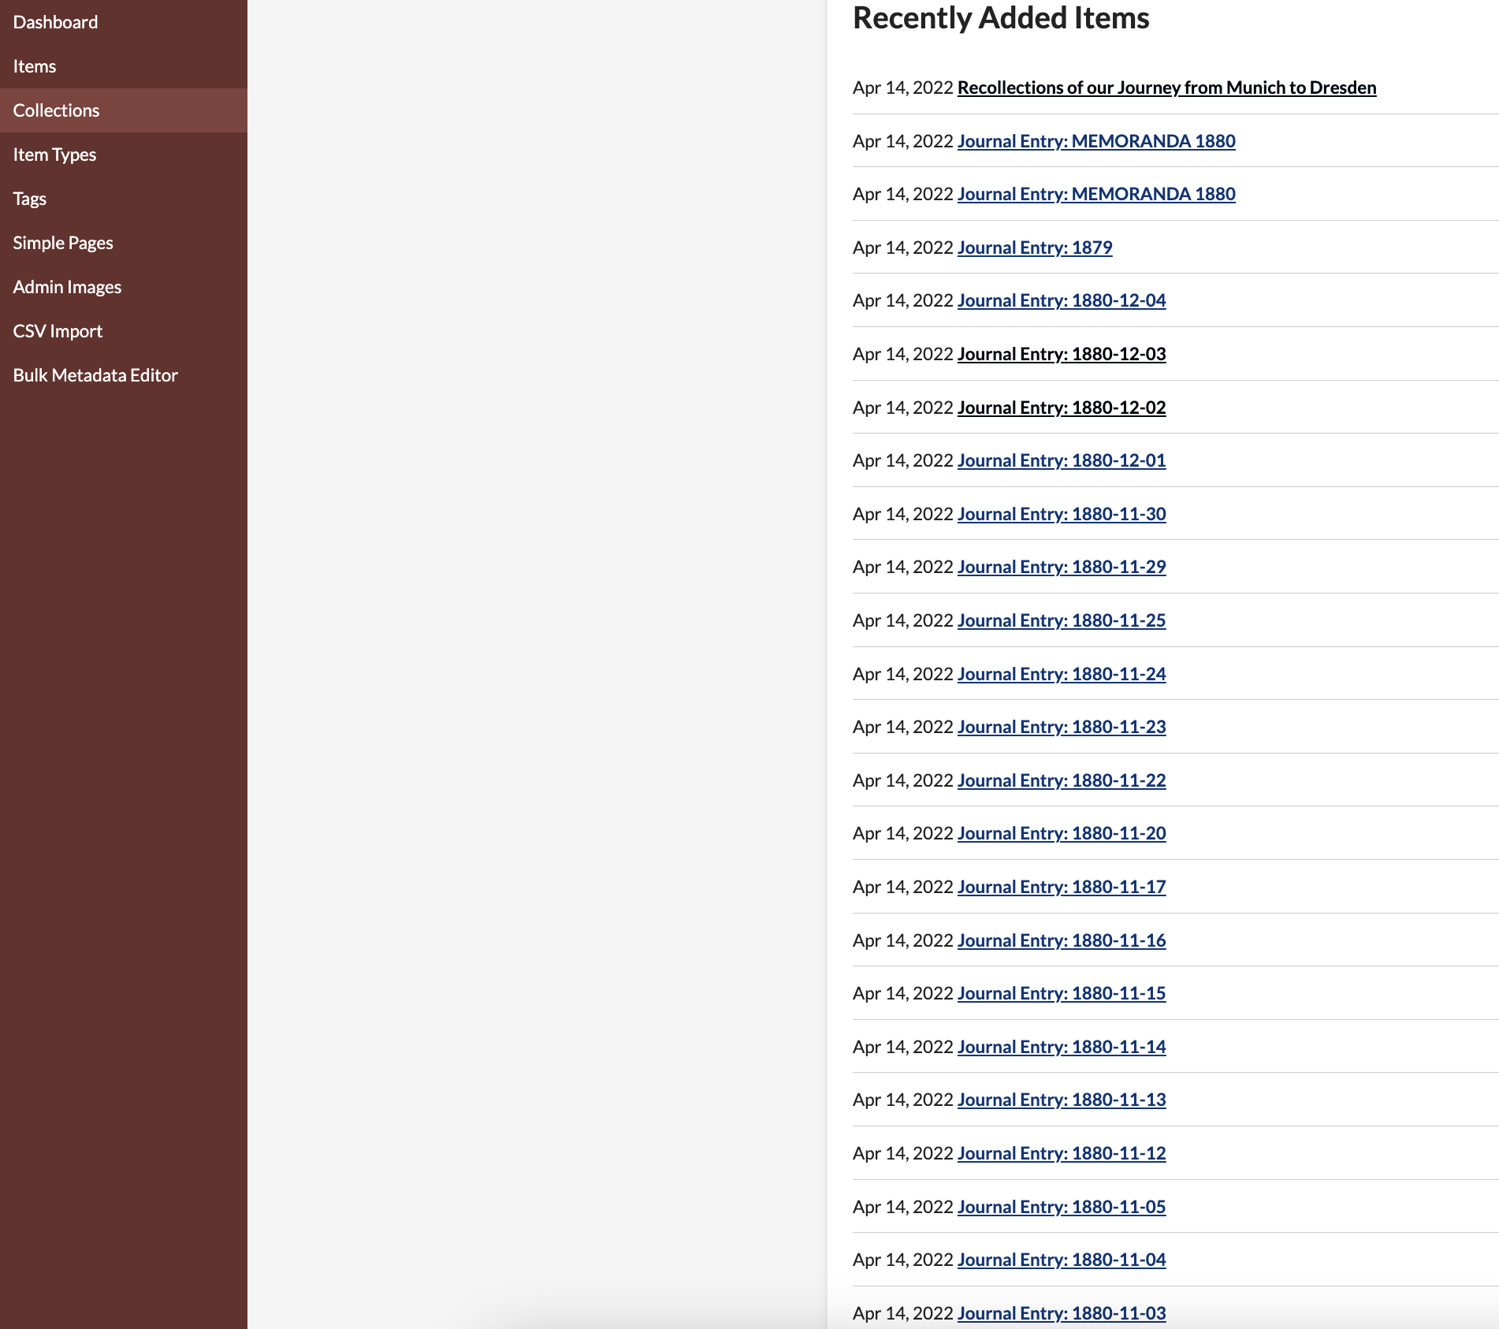
Cycle 1 Issues / Lessons Learned
Major Issue (resolved): Parsing data due to unsupported /n in .csv source file. Papa Parse library.
Remaining issues:
Dr Bev expressed interest to have real-time updating. Currently data is displayed from .csv file URL. The URL changes anytime an update (rare) is made.
This requires an admin to update the URL in the code… Real time will require completely a new & complex solution that pulls from web-hosted source vice .csv file source. ^ This will be the primary focus during Cycle 2.
Every entry is an individual URL.. Instead of a new row in a .csv file..

Slide 11
Plan
Cycle 2: Meet with Brad and Ravindra to review and discuss how the existing chronology pulls from the web-host and determine if a feasible solution to web-hosted data is possible. Develop a solution similar to the above for Journal search and display. Concerns: *Timeliness of search results *Data aggregation *Formatting
Cycle 3: Add functionality to the code in Cycle 2 to allow for hyperlink navigation and move interface from private to public visibility. Optionally, sync up with Team 6b to integrate journal entries into their chronology project.

Slide 12
Further Design Details
Language
This project will be utilizing a combination of Javascript, PHP, and CSS for this web-development project
Web-Tools and Resources
The George Eliot Archives uses several resources for hosting and collaboration. Front-end site: https://georgeeliotarchive.org/ Back-end site: https://georgeeliotarchive.org/admin/ A webhost of all journals: https://georgeeliotarchive.github.io Senior Design Documentation: https://auburn.app.box.com/ Public Github Repo: https://github.com/GeorgeEliotArchive
Migration
Journals will be collectively consolidated on the George Eliot Github page and migrated to the backend Archive hosting platform. (Completed) *This will be updated in Cycle 2 from .csv file sourcing to web-hosted source. No migration necessary. (In progress)
New Navigational Tab
A 'Journals' category will be added to the homepage of the George Eliot Archives. This tab will allow users to navigate to a new page which will display George Eliot's journals by year -> month.
(Completed ahead of schedule, currently in private-view)
Integration
In cycle 3, journal integration with the Team 6b project has been discussed.
Hyperlink Referencing
In cycle 3, it may be helpful for users to be able to navigate via hyper-linked text. For any such cases, this functionality should be available to users.

Slide 13
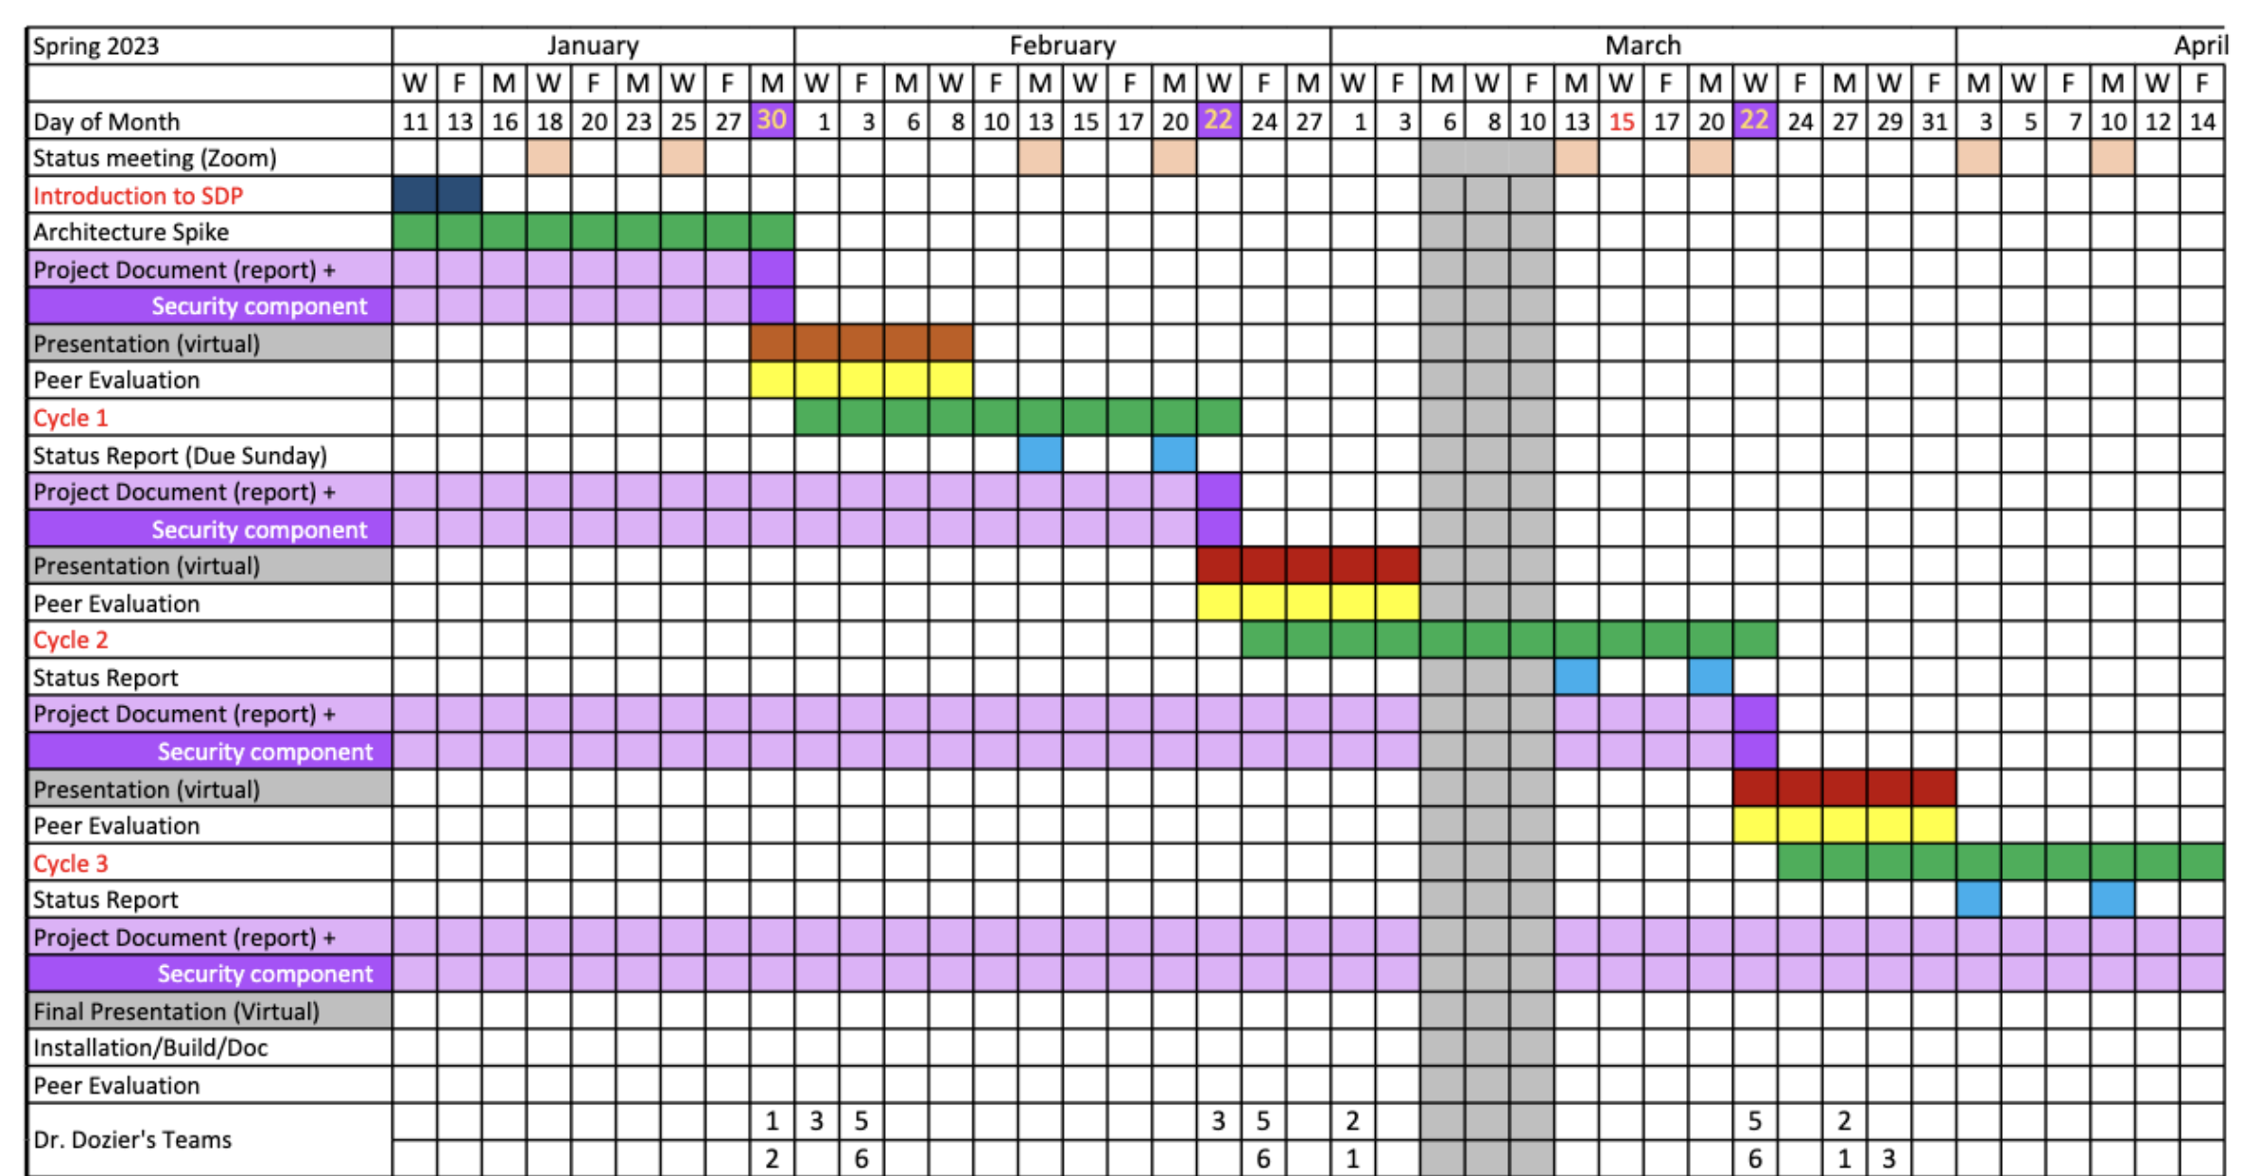
Class Schedule
YOU ARE HERE

Slide 14
Demo
George Eliot Archives
George Eliot Archives - Administration
Backend Collections

